Slide 1
#include<iostream>
using namespace std;
void main()
{
int a[3]={10,11,23};
for(int i=0;i<3;i++)
cout<<a[i]<<endl;
}

Slide 2
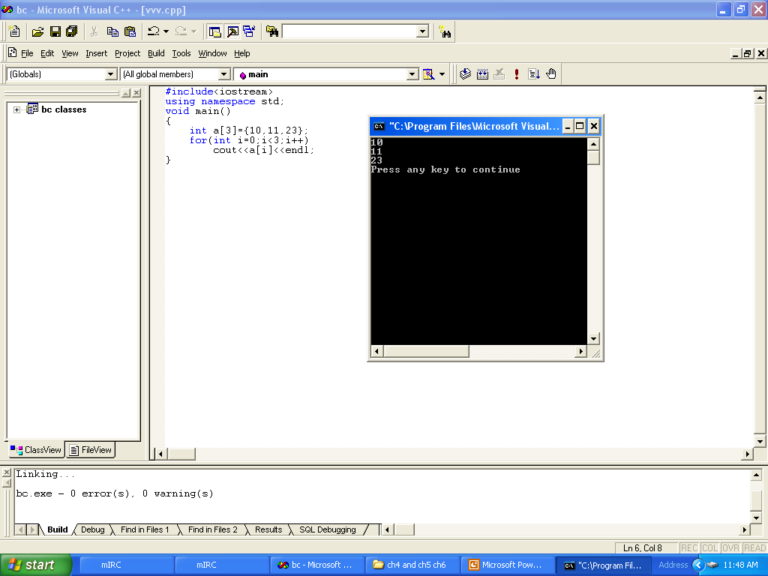

Slide 3
#include<iostream>
using namespace std;
void main()
{
int a[3];
cin>>a[5];
cout<<a[5]<<endl;
}

Slide 4
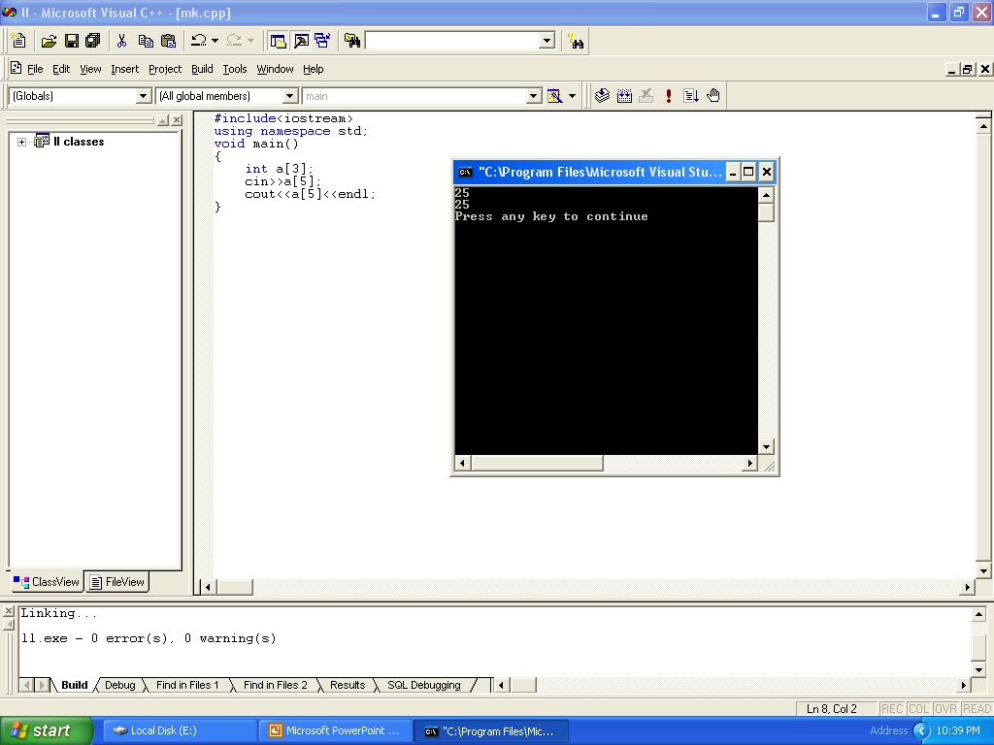

Slide 5
Referring to an element outside the array bounds is an execution-time logical error
It is not a syntax error

Slide 6
#include<iostream>
using namespace std;
void main()
{
int a[3]={10,11,23};
for(int i=0;i<4;i++)
cout<<a[i]<<endl;
}

Slide 7
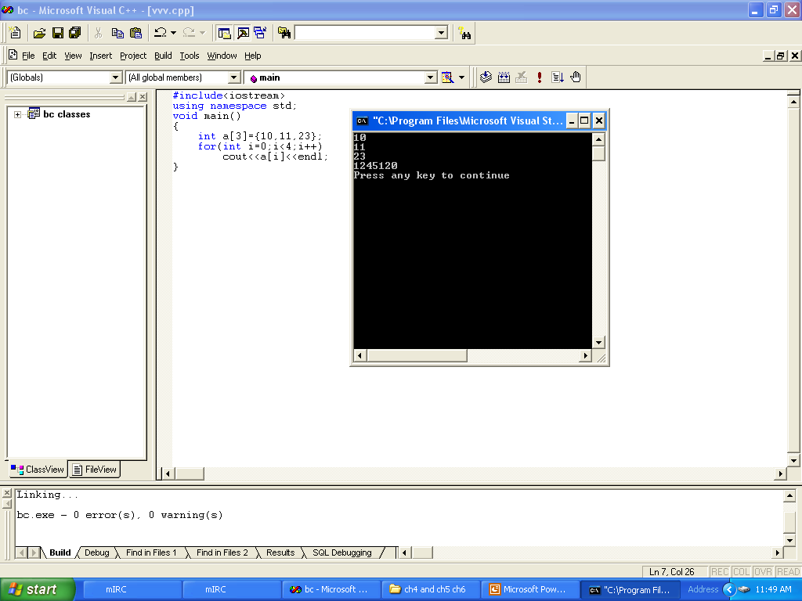

Slide 8
#include<iostream>
using namespace std;
void main()
{
int a[3]={10,11,23,11,44};
for(int i=0;i<4;i++)
cout<<a[i]<<endl;
}

Slide 9
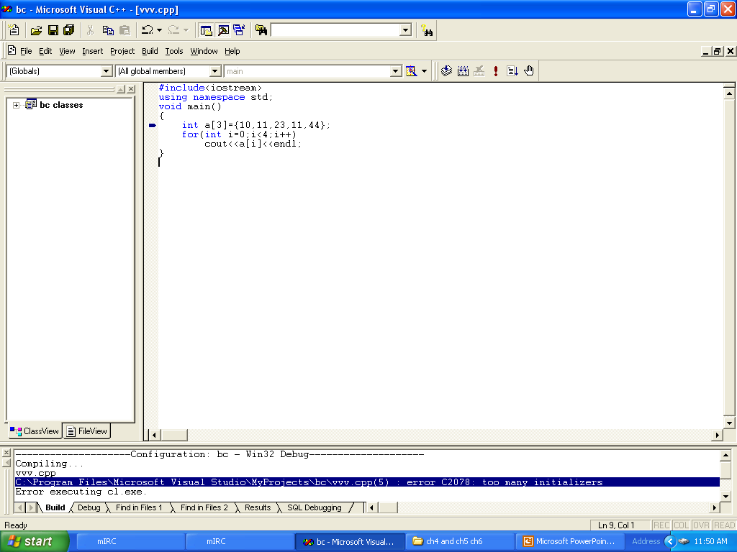

Slide 10
Providing more initializers in an array initializers list than there are element in the array is a syntax error

Slide 11
#include<iostream>
using namespace std;
void main()
{
char a[3]="hello";
}

Slide 12
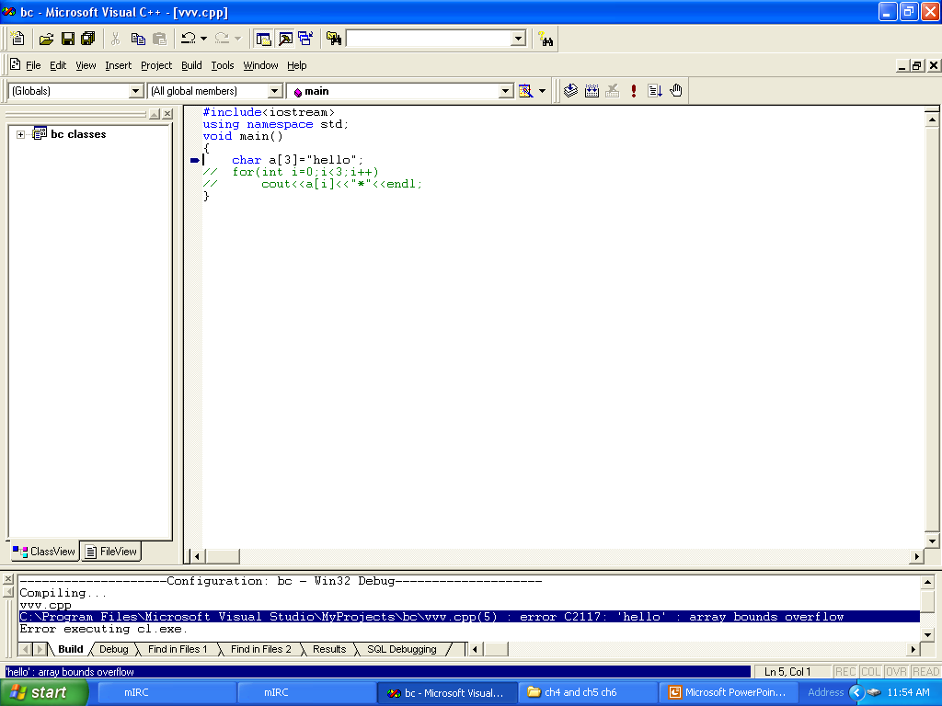

Slide 13
#include<iostream>
using namespace std;
void main()
{
char a[3]="hi";
for(int i=0;i<3;i++)
cout<<a[i]<<"*"<<endl;
}

Slide 14
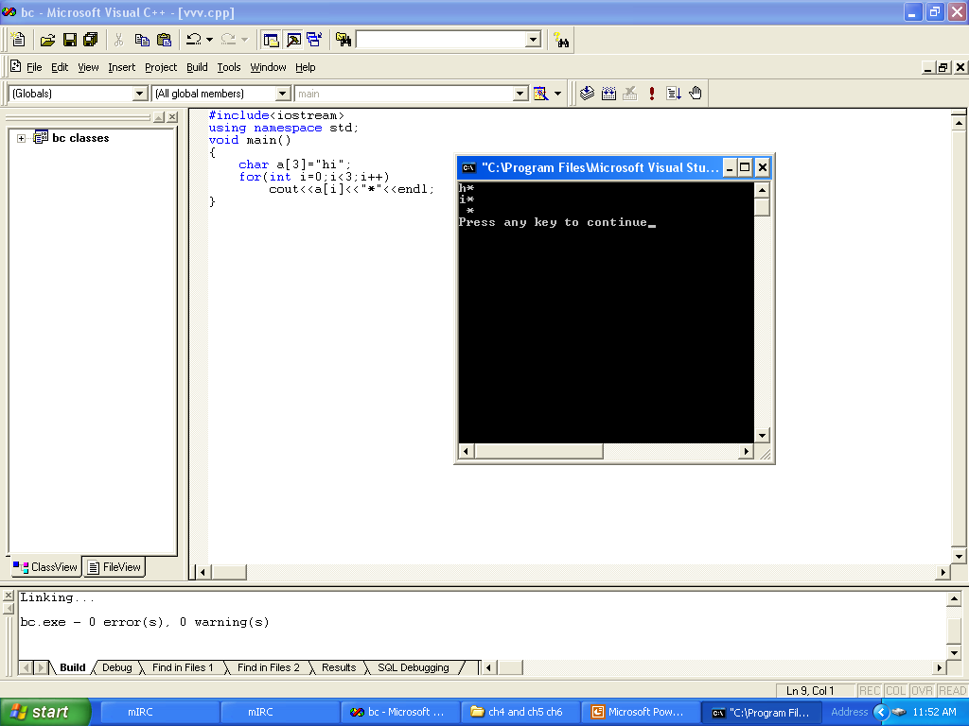

Slide 15
#include<iostream>
using namespace std;
void main()
{
char a[10]="hi";
for(int index=0;index<10;index++)
cout<<a[index]<<"*"<<endl;
}

Slide 16
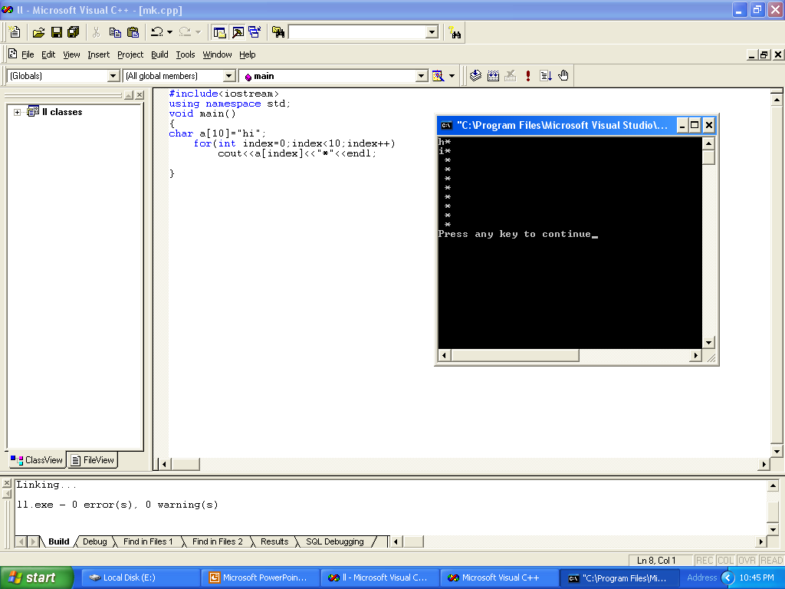

Slide 17
#include<iostream>
using namespace std;
void main()
{
char a[3];
cin>>a;
for(int i=0;i<3;i++)
cout<<a[i]<<"*"<<endl;
}

Slide 18
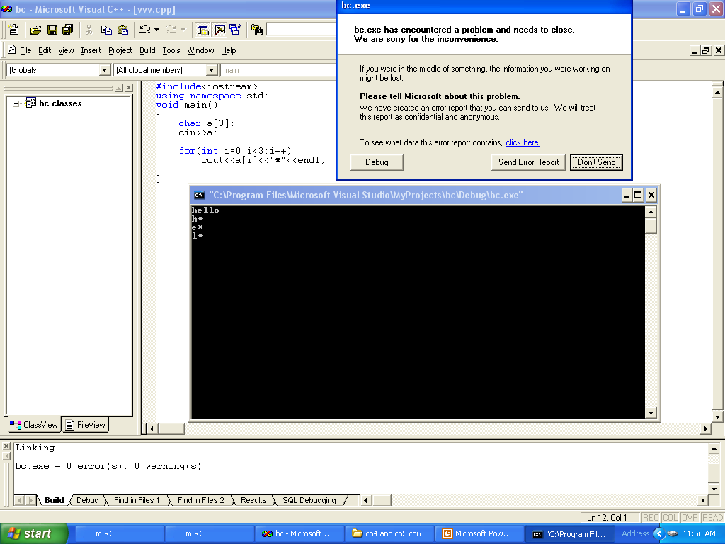

Slide 19
Not providing cin>> with a character array large enough to store a string typed at the key-board can result in loss of data in program and other run time error

Slide 20
#include<iostream>
using namespace std;
void main()
{
char a[3];
cin>>a;
for(int i=0;i<3;i++)
cout<<a[i]<<"*"<<endl;
}

Slide 21
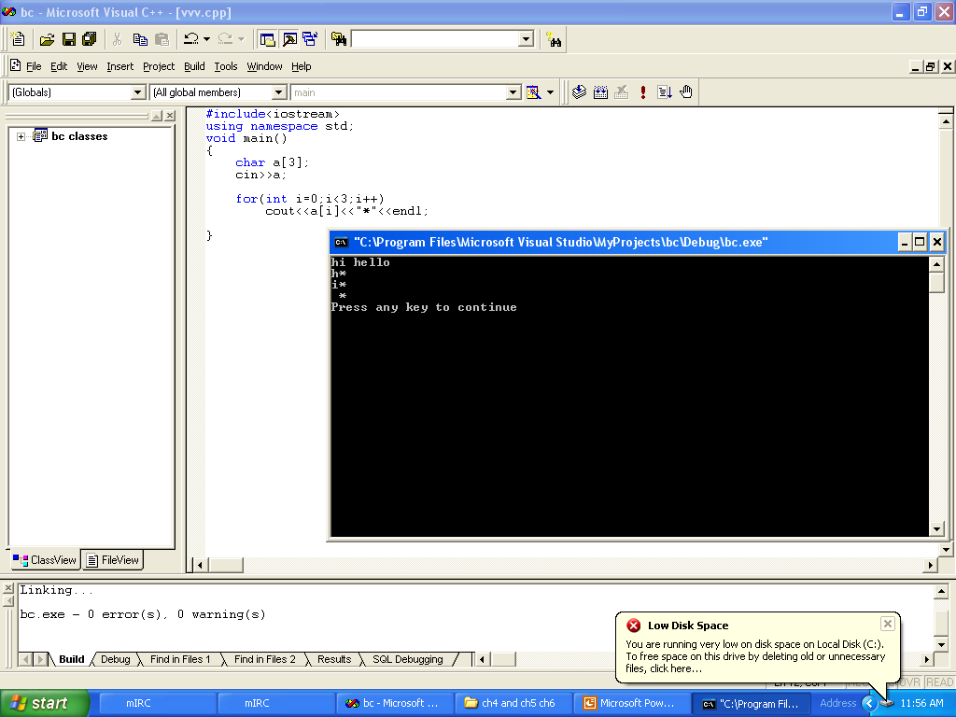

Slide 22
#include<iostream>
using namespace std;
void main()
{
char a[5];
cin.get(a,5);
for(int i=0;i<5;i++)
cout<<a[i]<<"*"<<endl;
}

Slide 23
//declaration istreamvar
ifstream infile;
String fileName;
cin>> fileName;
infile.open(fileName.c_str());

Slide 24
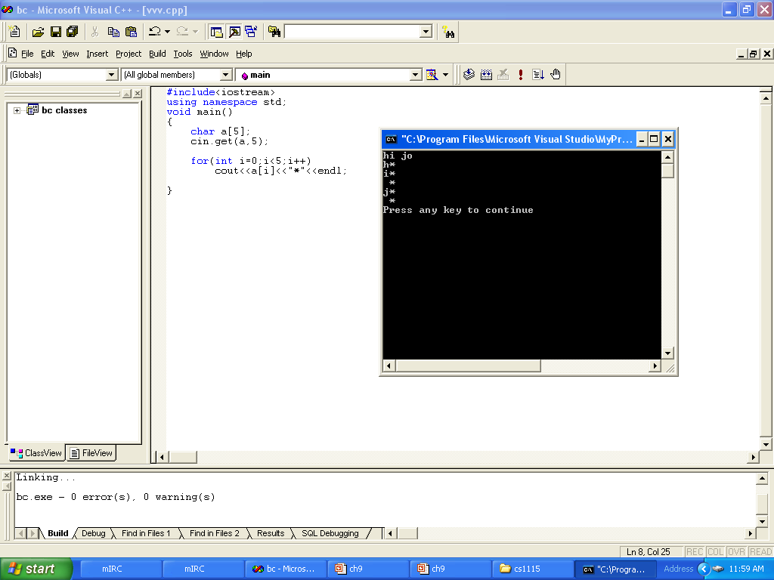

Slide 25
// Initializing multidimensional arrays
int array1[ 2 ][ 3 ] = { { 1, 2, 3 }, { 4, 5, 6 } },
array2[ 2 ][ 3 ] = { 1, 2, 3, 4, 5 },
array3[ 2 ][ 3 ] = { { 1, 2 }, { 4 } };
//print Array
for ( int j = 0; j < 3; j++ )
cout << a[ i ][ j ] << ' ';

Slide 26
// Initializing multidimensional arrays
// Initializing multidimensional arrays
#include <iostream>
using namespace std;
void printArray( int [][ 3 ] );
int main()
{
int array1[ 2 ][ 3 ] = { { 1, 2, 3 }, { 4, 5, 6 } },
array2[ 2 ][ 3 ] = { 1, 2, 3, 4, 5 },
array3[ 2 ][ 3 ] = { { 1, 2 }, { 4 } };
cout << "Values in array1 by row are:" << endl;
printArray( array1 );
cout << "Values in array2 by row are:" << endl;
printArray( array2 );
cout << "Values in array3 by row are:" << endl;
printArray( array3 );
return 0;
}
void printArray( int a[][ 3 ] )
{
for ( int i = 0; i < 2; i++ ) {
for ( int j = 0; j < 3; j++ )
cout << a[ i ][ j ] << ' ';
cout << endl;
}
}

Slide 27
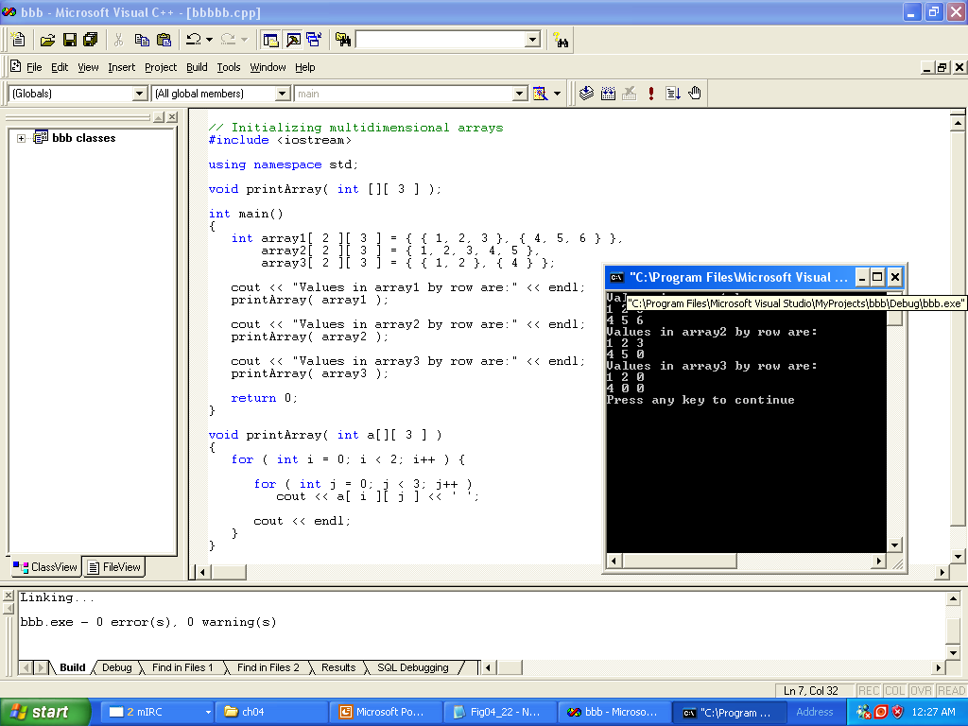

Slide 28
When declaring a two-dimensional array as a formal parameter
  Can omit size of first dimension, but not the second
Number of columns must be specified
void printArray( int a[][ 3 ] )
but
void printArray( int a[][] )؟؟؟؟؟؟؟؟؟؟؟؟

Slide 29
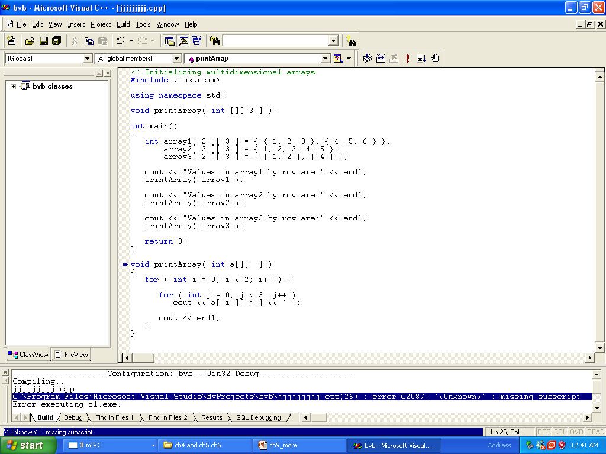

Slide 30
Referring a[x][y] incorrectly as a[x,y]
Acutely a[x,y] is treated as a[y] .
but not always
Try it with compiler.

